Slide 1
Survival Analysis in Programs Mark and R
Time-to-event or known-fate data
Reliability of a working part in an engine
Patient in a clinical trial
Nematode or mosquito in a jar
Germination and survival of a plant seedling
Fate of eggs or young in a bird nest
Time until desertion of dependent young
Fate of a radio-marked bird
Statistical models
Kaplan-Meier models: patterns of mortality
Cox Proportional Hazards: factors affecting mortality
Hazard functions: instantaneous probability of mortality
An empirical example
Winder et al. 2014. Wind power and prairie-chickens

Slide 2

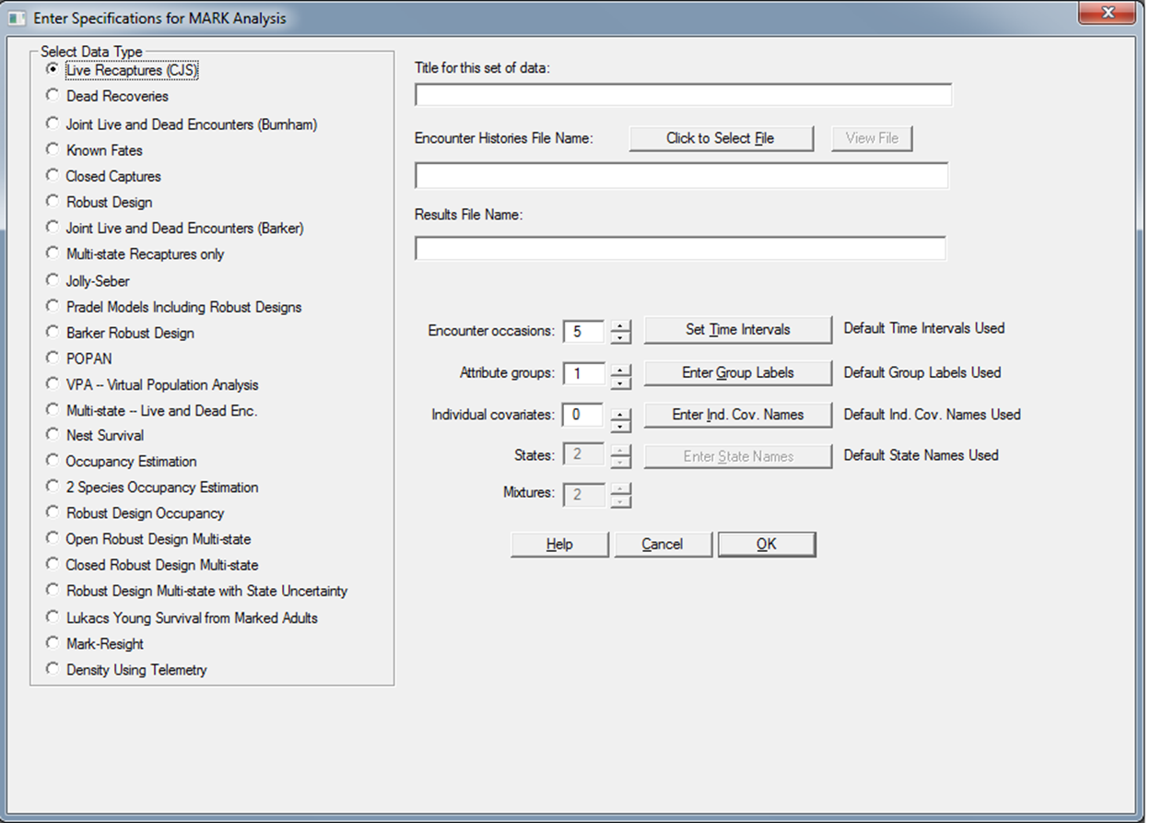
Known Fate Models in Program Mark
Known fates (LD format), nest survival (entry, lastalive, exit, fate)
Time-to-event with perfect detection (p=1)

Slide 3
Data Analyses in Mark
Known Fate Model
Encounter histories with LD format for each occasion
10 for alive and survived the interval
11 for alive at start of interval but then recovered dead
00 used to censor an individual that was not detected
01 is not allowed
Considerations
Encounter histories can have any time step, daily, weekly, biweekly, monthly
Program Mark provides estimates of weekly survival but cannot calculate hazard functions
Program R estimates cumulative survival and has hazard functions

Slide 4
Data Analyses in Mark
Nest Survival Model (or Ragged Telemetry Data)
k = date of nest discovery or date of capture for telemetry
l = last date that the nest or individual was known to be alive
m = date that final fate of the nest or individual was determined
f = fate of nests or individuals where 0 = successful and 1 = failed
n = number of nests or individuals with same encounter history
Considerations
Encounter histories can have any time step, daily, weekly, biweekly, monthly. Coarse time-step better as S approaches 1.
First day of the sampling period must be coded as 1
Total number of intervals in the PIM's is the difference between 1 and the maximum value of m.
For successful nests, l = m, and for failed nests, l < m.
No. of parameters often undercounted in S(t) if parameter estimates are high and close to the boundary of one

Slide 5
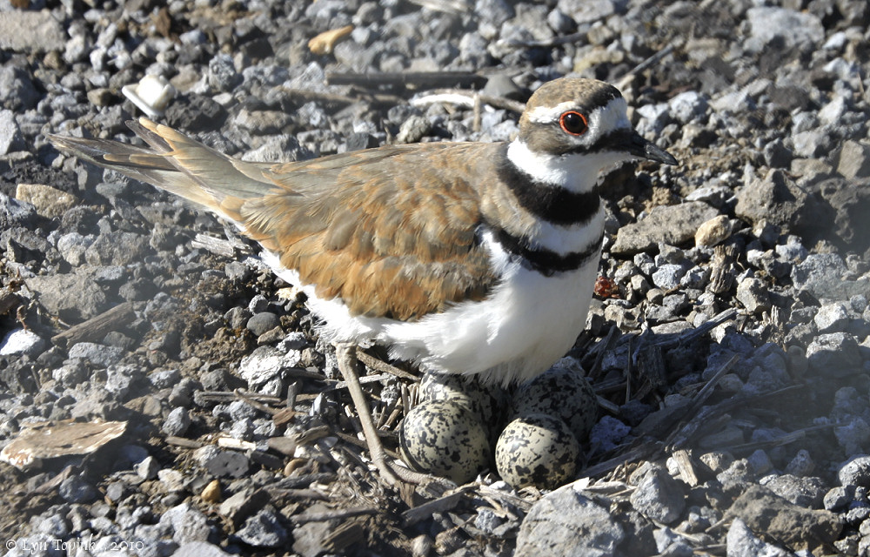
killdeer.inp

Slide 6
Data Format for R
Comma-delimited file
Identify experimental units: Individuals or groups (bird band number and radio frequency)
Dates of exposure:
Staggered entry or left-censored: entry and exit
Cohort monitoring: exit only
Event during monitoring:
1 = failed or died
0 = alive or event did not occur by end of period
Explanatory variables: Levels of experimental treatments (pre vs. post), different groups (age, sex), continuous covariates (distance to turbine)

Slide 7
Calculations for Survival
Cumulative Survival - Kaplan-Meier Method
S = cumulative survival, i = intervals, k = unique death times, d = no. of deaths, v = no. of subjects at risk
Cumulative Hazard - Nelson-Aalen Method
h(t) is the instantaneous probability of mortality, calculated as first derivative (slope) of H(t), fit with parametric splines
Murray 2006 J. Wildl. Mgmt

Slide 8
Data Analyses in R
Functions of survival package
Surv(): processes the entry, exit and event data
survfit(): fits Kaplan-Meier models
cox.zph(): tests assumption of proportional hazards
coxph(): fits Cox proportional hazards models
Functions of gss package for hazard rates
Surv(): processes the entry, exit and event data
sshzd(): fits spline model for hazard rates, alpha is a smoothing parameter for the spline
hzdrate.sshzd(): calculate values for hazards given a vector of times

Slide 9
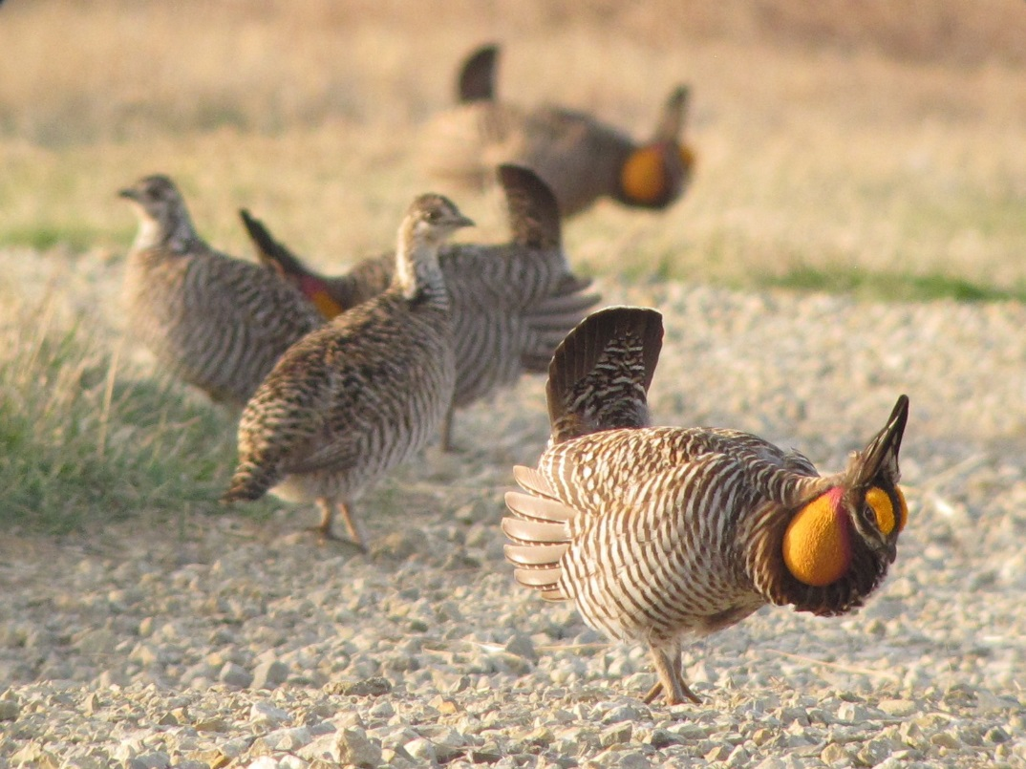
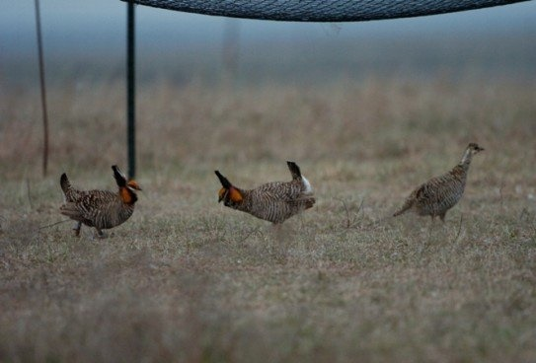
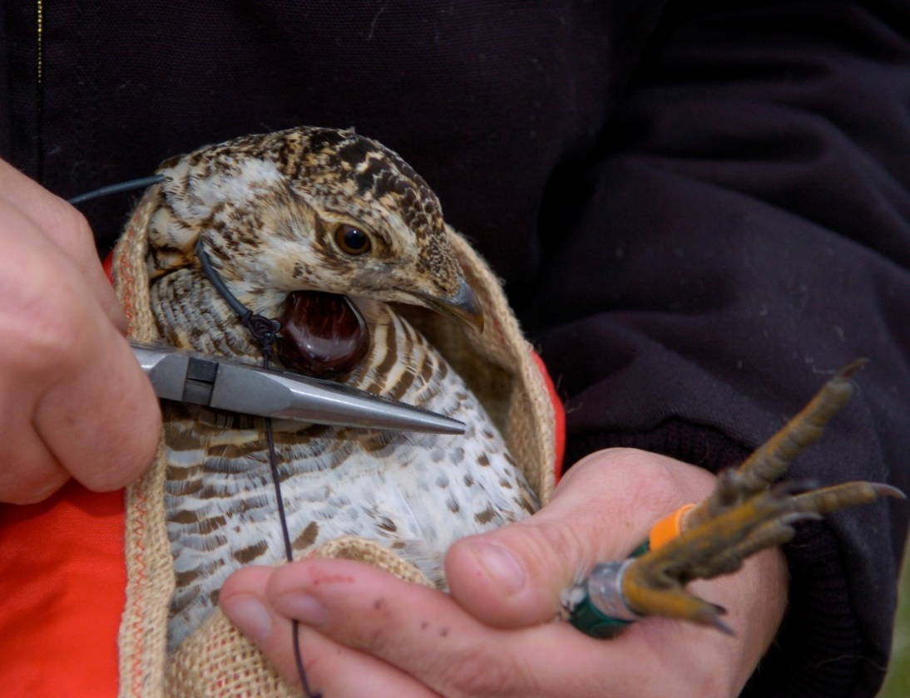
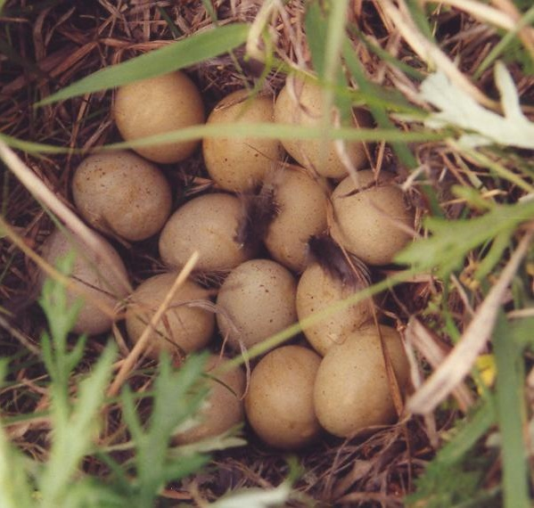
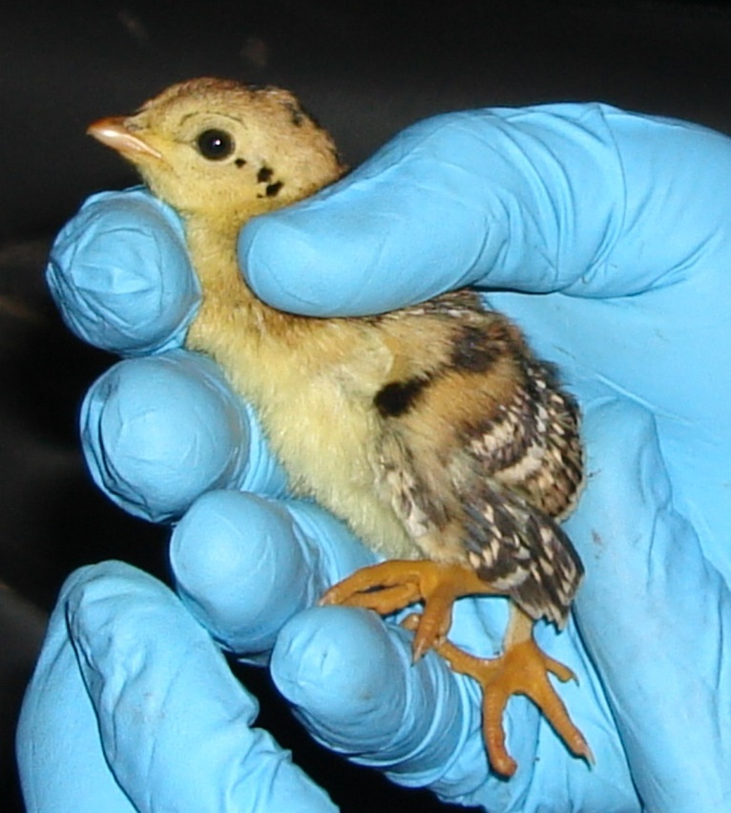
VHF radios (30 mo)

Slide 10

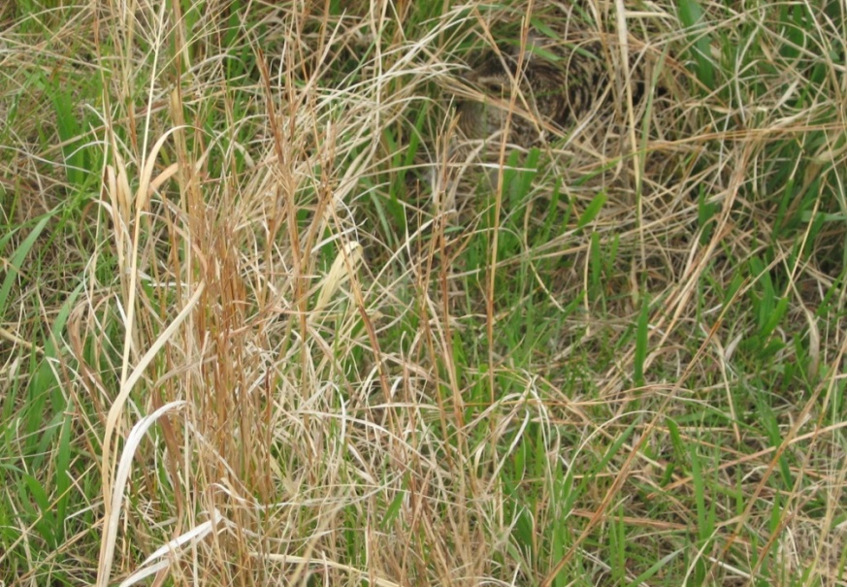
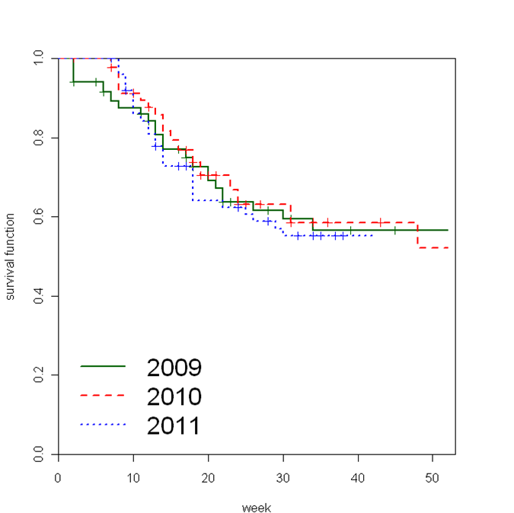
Survival and Vulnerability to Predators
n = 74 females
81 bird-years
41 mortalities
n = 177 females
206 bird-years
63 mortalities
Kaplan-Meier, Cox proportional hazards, hazard functions in R
Cumulative survival
Winder et al. 2014
J. Appl. Ecol.
Pre
Post
Week from 1-7 March

Slide 11
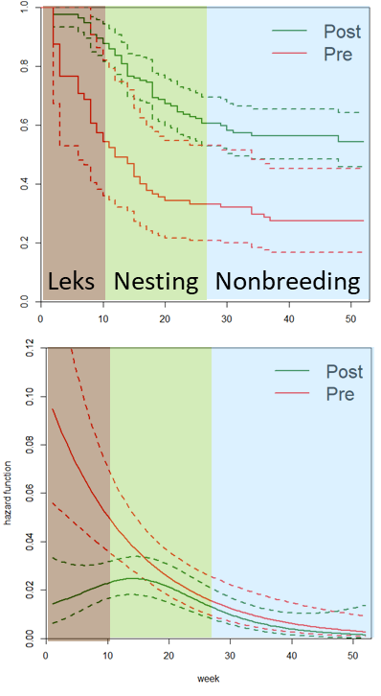
Major Results
Survival increased after wind development from 0.274 to 0.543
Distance to turbine had no effect
Hazard rates ~5× higher in lekking (weeks 1-10) during preconstruction
Hazard rates high during nesting (weeks 11-26) in both periods
Little evidence of winter mortality (weeks 27-52)
Conclusions
Turbines did not increase risk of collision mortality
Presence of turbines might have disrupted predator activity?
Cumulative survival
Hazard rate
Week from 1-7 March

Slide 12
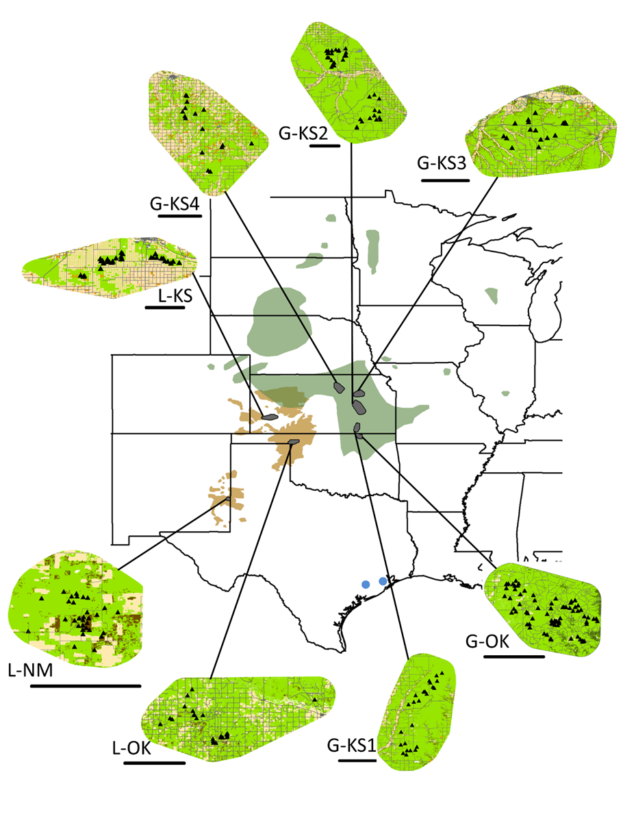
Survival of female prairie chickens
Eight populations: 1997-2013
Site: Longitude | Habitat | Rain (cm) | No. fem. | Bird-years | No. dead
L-NM: 103.3°W | Sand shinnery oak prairie | 38.0 | 504 | 882 | 218
L-KS: 100.9°W | Sand sagebrush prairie | 50.2 | 160 | 196 | 49
L-OK: 99.9°W | Mixed grass prairie | 58.1 | 474 | 793 | 254
G-KS4: 97.7°W | Mixed grass prairie | 73.6 | 220 | 270 | 95
G-KS2: 96.3°W | Tallgrass prairie | 80.8 | 140 | 179 | 64
G-KS3: 96.5°W | Tallgrass prairie | 90.8 | 98 | 125 | 50
G-KS1: 96.6°W | Tallgrass prairie | 115.5 | 53 | 72 | 22
G-OK: 96.4°W | Tallgrass prairie | 129.2 | 203 | 304 | 76
Lesser
Prairie-Chickens
Greater
Prairie-Chickens
Sandercock et al., unpubl. ms.

Slide 13
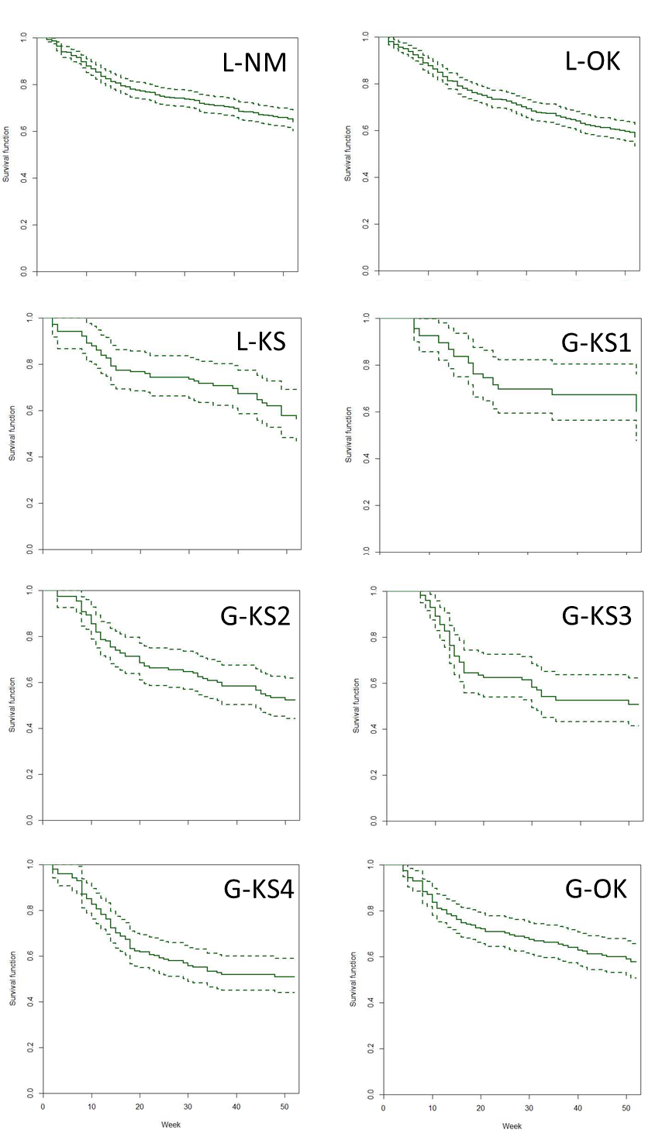
Cumulative survival of females in eight populations
Biological year, weekly time step
March 1-7 to Feb 23-29
4.5 yrs per study (3 to 12 yrs)
Sample sizes
Total: 2,821 bird-years for 1,857 females, with 828 deaths
Median: 233 bird-years (72 to 882) for 181 females (53 to 504), with 70 mortalities (22 to 218)
Annual survival rates
Lessers: 0.56 to 0.64
Greaters: 0.50 to 0.60
S = 0.64
n = 504 birds/882 years
S = 0.57
n = 474 birds/787 years
S = 0.56
n = 160 birds/196 years
S = 0.60
n = 53 birds/72 years
Cumulative survival
S = 0.52
n = 140 birds/179 years
S = 0.51
n = 98 birds/125 years
S = 0.51
n = 220 birds/270 years
S = 0.58
n = 203 birds/304 years
Week of year

Slide 14
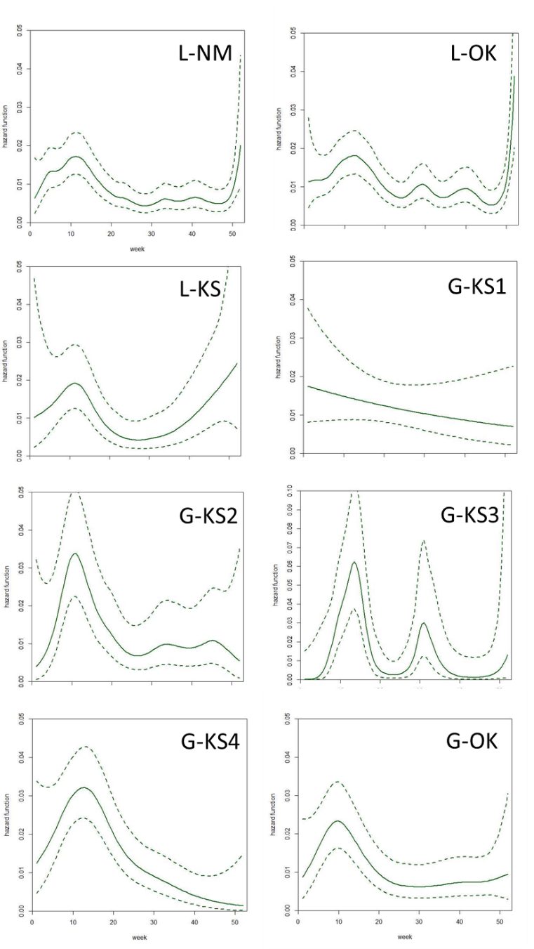
Hazard rates vs. causes of mortality
Raptor
Collision
Mammal
Mammal
Hazard rates
Raptor
Mammal
Mammal
(No data)
Week of year

Slide 15
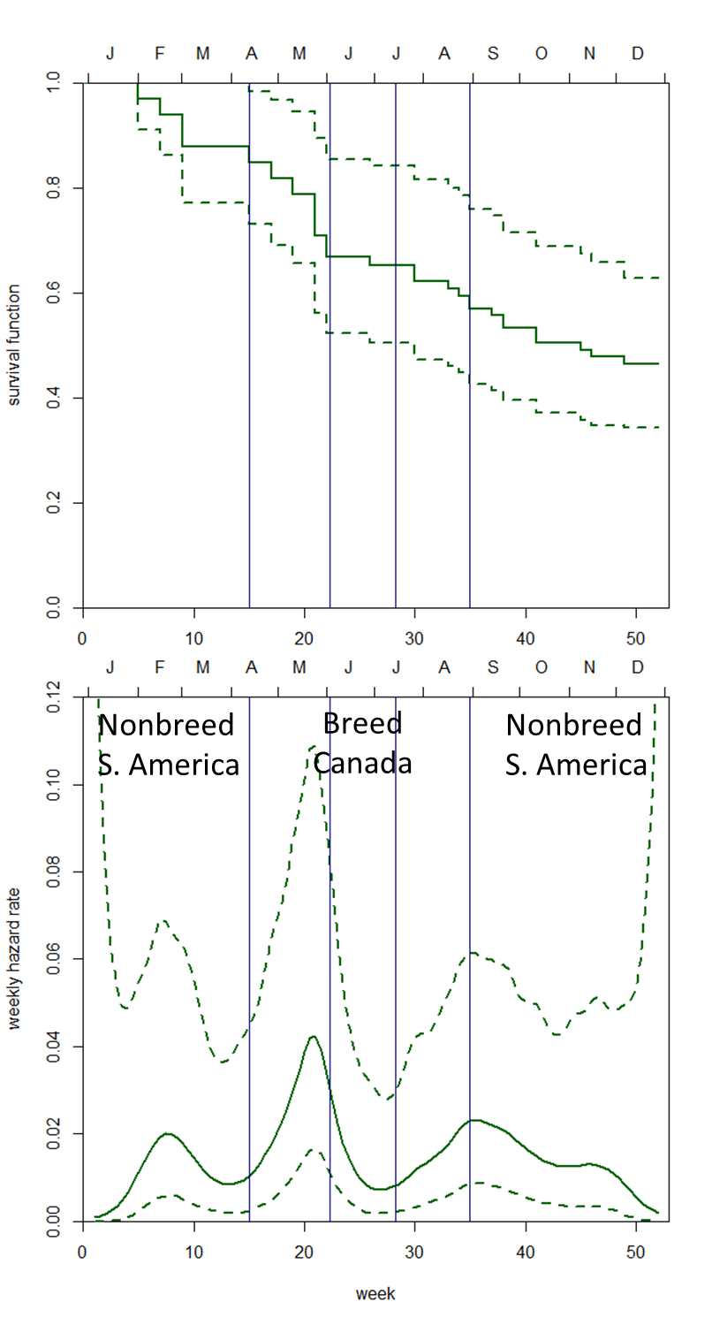
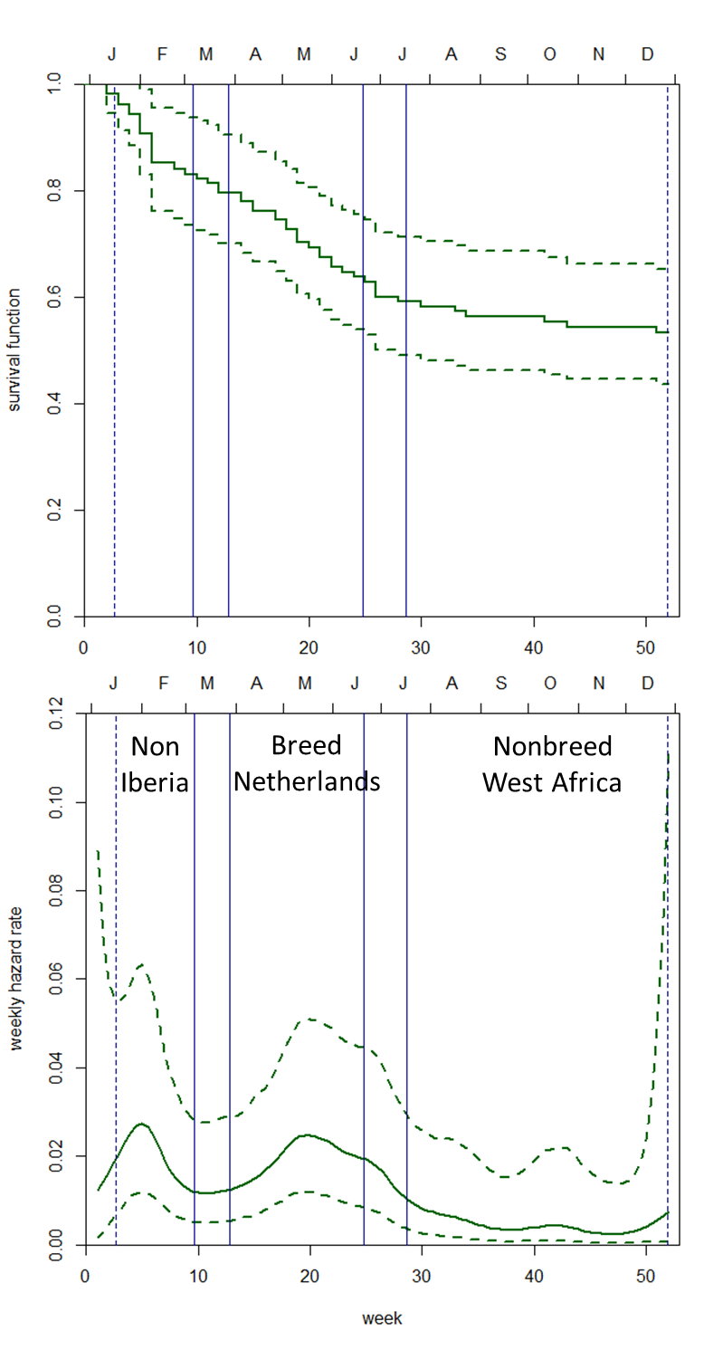

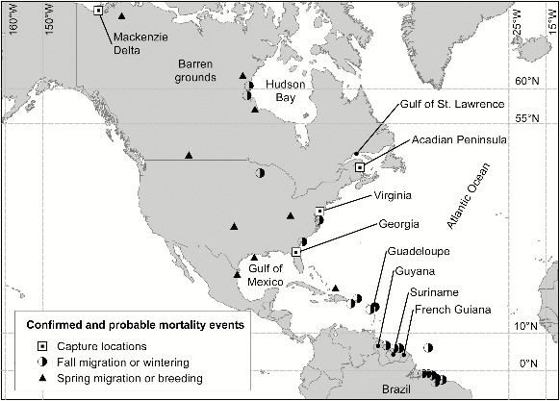
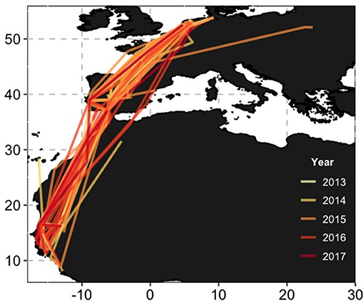
Continuous-time models for migratory waders
Cumulative survival
S=0.464
95%CI=0.343-0.628
S=0.534
95%CI=0.436-0.653
Whimbrel
Western Atlantic
Black-tailed Godwits
Eastern Atlantic
Week hazard
Week of year
Watts et al. 2019 Condor 121:1-13
Senner et al. 2019 Frontiers Ecol. Evol. 7:art96

Slide 16
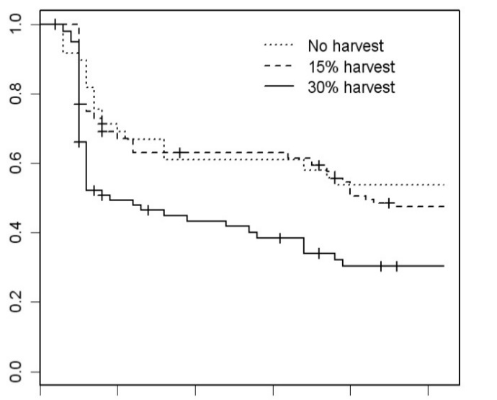
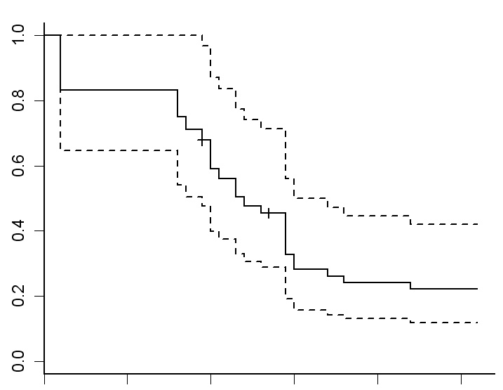
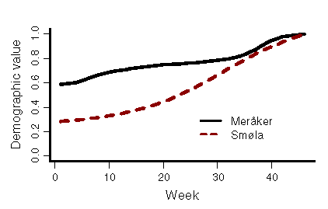

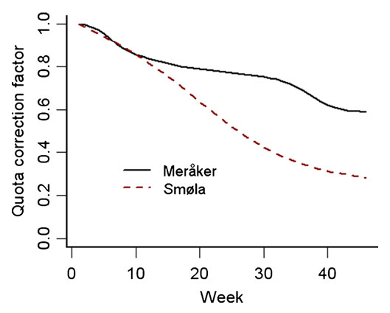

Continuous-time models for Willow Ptarmigan
Mainland mountains
Coastal islands
Demographic value of
survivors (DV_{t} = exp[Σ-H_{t}])
Cumulative survival (S_{t})
Meråker
Smøla
n = 193 birds for
269 bird-years
n = 32 birds for
44 bird-years
Quota (CF_{t} =DV₀/DV_{t})
Weekly hazard rates
A
J
J
J
J
S
O
N
D
J
F
M
A
M
A
S
O
N
D
J
F
M
A
M
Month of year
Sandercock et al. 2011. J. Anim. Ecol. 80:244-258
Brøseth et al. 2012. Eur. J. Wildl. Res. 58:797–802

Slide 17
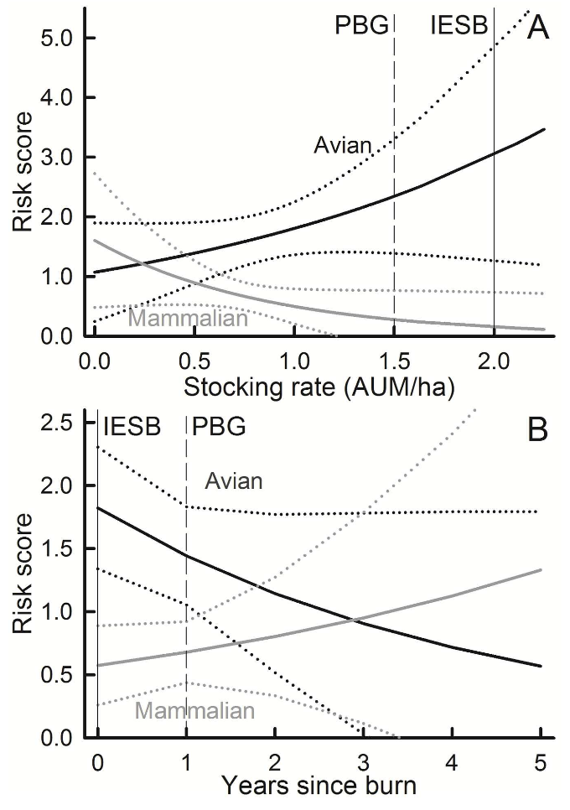
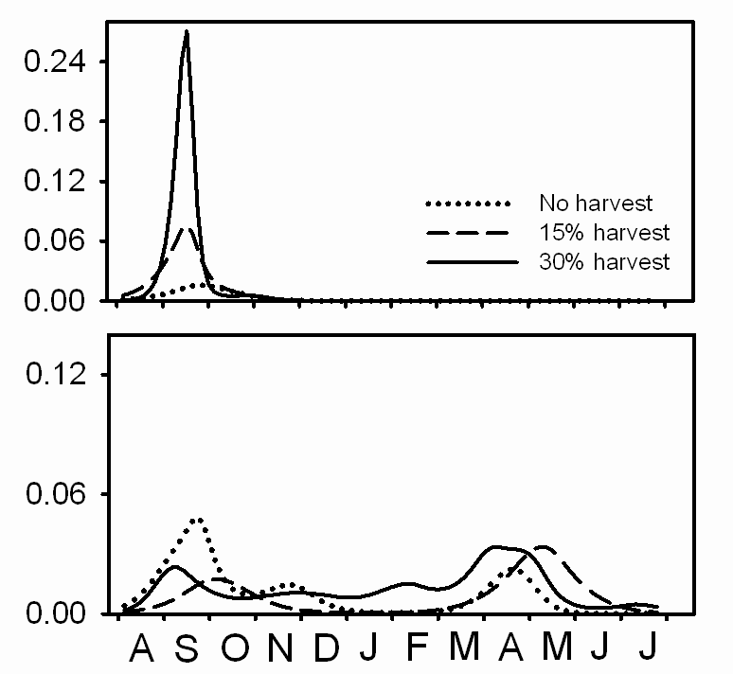

Competing risks with continuous-time models
i) Nonparametric cumulative incidence function estimator
ii) Andersen-Gill models
Greater
Prairie-Chickens
Harvest
Avian
Mammalian
Hazard rate
Willow Ptarmigan
Predation
Mammalian
Avian
Month of year
Sandercock et al. 2011 J. Anim. Ecol. 80:244-258
Winder et al. 2017 J. Wildl. Mgmt. 82:113-122

Slide 18
Summary
Program Mark
Two procedures for data analysis: known fate and nest survival
Model estimates for daily or weekly survival rates
Fixed effects only, random effects allowed in logistic exposure models (SAS code)
Program R
survival and gss packages of Program R: Kaplan-Meier and Cox proportional hazards
Model estimates for cumulative survival
Hazard functions allow identification of periods of peak mortality

